Slide 1
Make My Trip
Project Gladiator Group-8 Set-4
Manumitha Kamarapu (TL)
Prathamesh Baxi
Sadhvika K V L
Shivam Lahoti
Vineet Abraham

Slide 2
Scope & Application
Scope
To confirm functionality of the given business requirements, i.e.
Login.
Registration.
Searching and booking of Flights.
Searching and booking of Hotels.
Cross browser testing.
To provide appropriate testcases and validations to check for and test key features.
To provide reports and evidence of test failures and abnormal behaviours.
To automate the process of testing the aforementioned functionalities.
Application

Slide 3
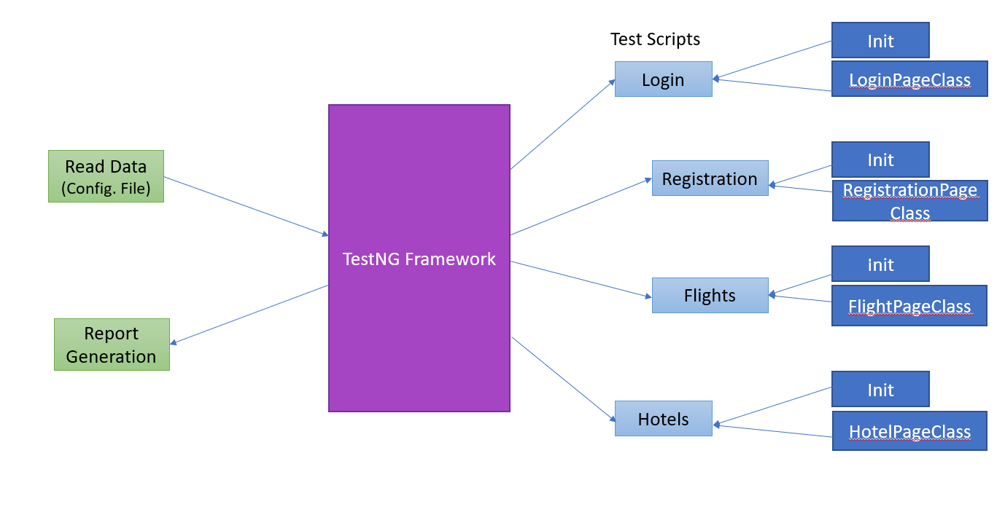
Architecture

Slide 4
Schedule
Tasks, Estimated Efforts And Target Dates Of Completion.
Task | Estimate effort | Target Completion Date
Requirement Analysis & Test planning | 24 Hours | Tuesday, 28/09/21
Test Analysis & Test Design (Test Case writing) | 24 Hours | Wednesday, 29/09/21
Test script writing | 80 Hours | Thursday, 30/09/21
Test Execution | 12 Hours | Friday, 1/10/21
Report generation and defect writing | 20 Hours | Monday, 4/10/21

Slide 5
Test Case Designing
The approach followed can be summarised as :
The business requirements were understood and discussed and divided among team members.
These assigned requirements were then broken down into automatable and deliverable testcases pertinent to and critical for the functionality to pass.
The requirements were divided as follows:
Requirement | Assigned Personnel
Registration | Shivam Lahoti
Login | Sadhvika K V L
Flight search and booking | Prathamesh Baxi
Hotel search and booking | Manumitha Kamarapu
Validation & Integration | Vineet Abraham

Slide 6
Test Case Designing
Registration

Slide 7
Automation Approach

Slide 8
Challenges Faced
What Were The Challenges Faced And What Work-arounds Were Implemented.
During the project, a variety of challenges were faced and worked around.
Key challenges faced were:
The website being in a production environment undergoes changes regularly.
Slow server responses leading to failure in locating elements by selenium.
Maximum Login attempt limit prevented testing after a certain number of runs.
Requirement of new mobile numbers and emails every time the registration feature had to be tested.
Unpredictable behaviors in flight booking like occasional presence or absence of elements.
These Challenges were worked around using the following approaches:
Multiple checks and test were made to catch and report any updates.
Waits were implemented wherever required to allow the script and the website to work in unison.
Email Generator was used to provide with fresh emails to test registration functionality.
Unexpected behaviors were tracked using try-catch blocks and reported as abnormal behaviors.

Slide 9
Project Takeaways
The Lessons Learned..
In the duration of this project the team imbibed and inculcated the following values:
Coding from a maintenance point of view.
Standard practices adopted during coding.
Division of tasks and integrating efforts.
Scheduling of projects and following timelines.
The importance of teamwork, coordination and communication.
Difference between a live environment and test environment.

